Slide 1
Report
for Dec-2021 to March-2022 MP
BFX – UA300
Date : 25-Apr-2022
Prepared by: Rachel Ruan

Slide 2
Issue Description
22-Apr-2022, ALT customer complain [BFX-UA300] Dec-2021 to March-2022 Mass production issue.
Overall inspection result => Fail ( Waived, due to product launch schedule )
Defect Total:
•Critical
1. No boot * 1pcs - Defect unit Q’ty : 1pcs / 315 pcs
2. Aux is not working * 1pcs - Defect unit Q’ty : 1pcs / 315 pcs
•Major
1. Acetic tape missing * 1pcs
2. KC label attachment NG * 1 pcs
3. LED FFC bad assembly * 1pcs
4. Inside the screw * 1 pcs
5. NUGU LED slightly different color * 1 pcs & NUGU LED partially different color * 1 pcs
•Minor
1. Acetic tape misalign * 1 pcs
2. Grill assembly NG * 1 pcs

Slide 3
1. No Boot
Issue Description | Root Cause | Actions | Owner | Due Date | Status
Symptom: No boot Type: Critical Defect unit Q’ty : 1pcs / 315pcs Defect rate : 0.31% SKB SN: 2149695001202109009014 |  | - Fii is analysising inprocess | PE-Micheal | 16-May

Slide 4
2. AUX not working ( PE analysis report )
Issue Description | Root Cause | Actions | Owner | Due Date | Status
Symptom : Aux is not working . Type: Critical Defect unit Q’ty : 1pcs / 315pcs Defect rate : 0.31% |  | - Fii is analysising inprocess | PE: Micheal | 16-May

Slide 5
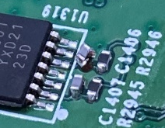
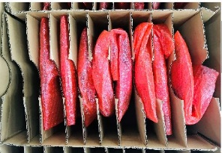
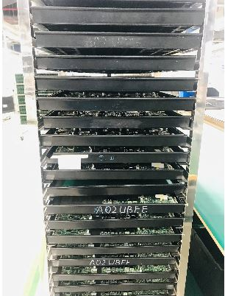
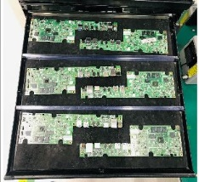
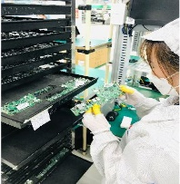
2. AUX not working ( ME analysis Report )
Issue Description | Root Cause | Actions | Owner | Due Date | Status
Symptom : Aux is not working . Type: Critical Defect unit Q’ty : 1pcs / 315pcs Defect rate : 0.31% | Aux is not working, R2945 and R2946 PCB pattern was broken. Root cause: 1. Because the product after cutting the plate, must wait for the assembly materials, so it is necessary to pack the PCBA. 2.Abnormalities occur during PCBA packaging pending assembly, PCBA is packed in a carton, when removing PCBA increases the risk of components collision between products. | Waiting NG sample for further analysis. Corrective Actions: Use product carrier TRAY instead of cartons, reducing the risk of collisions between PCBA sheets, convenient for staff to operate. Status : Done Before assembling PCBA, ask staff to check the appearance in high-risk locations. Update operations and items in the assembly SOP of the product. Status : Done | PE: Micheal ME:Chenglun | 27-Apr
Before Improved
After Improved

Slide 6
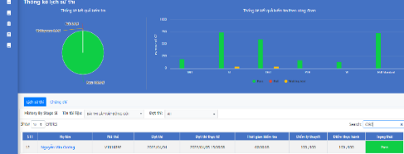


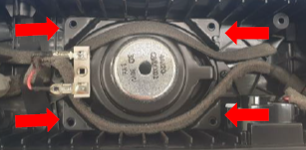
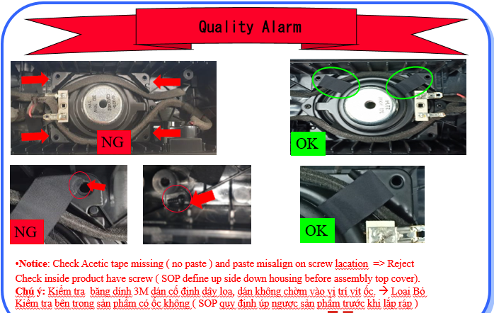
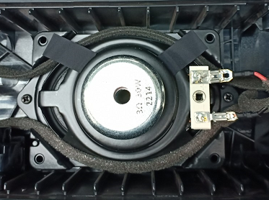
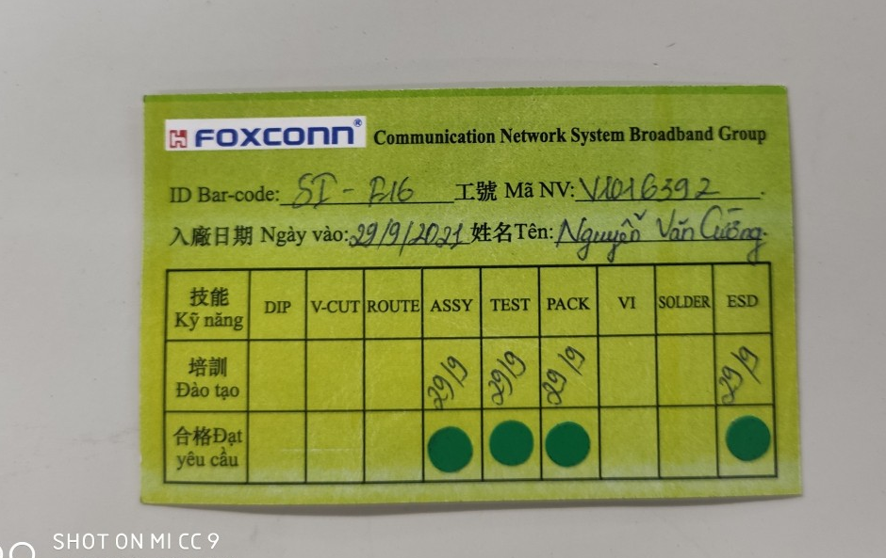
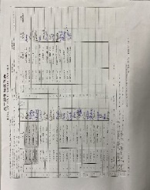
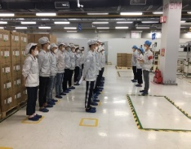
3. Acetic tape missing
Issue Description | Root Cause | Actions | Owner | Due Date | Status
Symptom : Acetic tape missing Type: Major Defect unit Q’ty : 1/315 pcs Defect rate : 0.31% | 1. This station OP forget paste Acetic tape. Doing no follow SOP. V1016392 Nguyen Van Truong Line 8 | 1. Update training on system for this OP learned and pass exam. Status : Done 2.Hang Quality arlam online for OP notice it. Status : Done 3. Before run line , line leader training OP, notice quality online issue, IPQC defect issue, OBA issue, read SOP and quality alarm. Status : Done | PQE:Rachel IE: Mei Ling PD:Van Anh ME: Cheng Lun SQE: Mouse | 27-Apr
OK

Slide 7
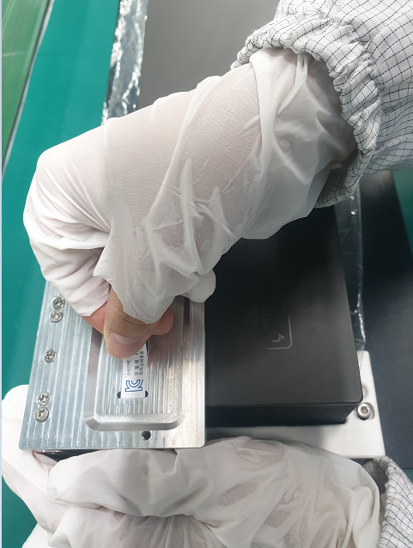
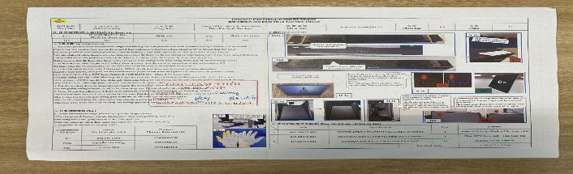
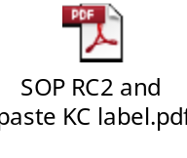
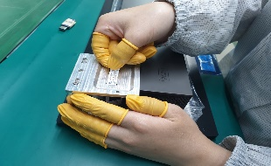
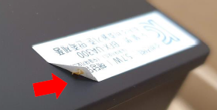
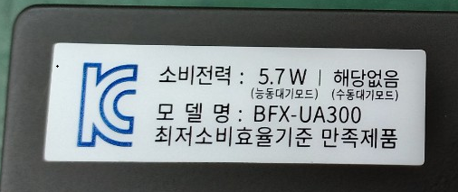
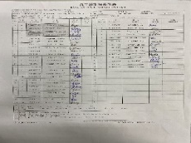
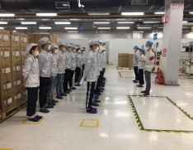
4. KC label attachment NG
Issue Description | Root Cause | Actions | Owner | Due Date | Status
Symptom : KC label attachment NG Type: Major Defect unit Q’ty : 1/315 pcs Defect rate : 0.31% | From KC label picture, Under label have finger rubber torn. | 1. SOP define cut 2 head finger rubber update by IE and QA at this station. Status : Done 2. Hang Quality arlam on this station for OP notice it. Status : Done 3. Before run line , line leader training OP, notice quality online issue, IPQC defect issue, OBA issue, read SOP and quality alarm. Status : Done | PQE:Rachel IE: Mei Ling PD:Van Anh ME: Cheng Lun SQE: Mouse | 27-Apr

Slide 8
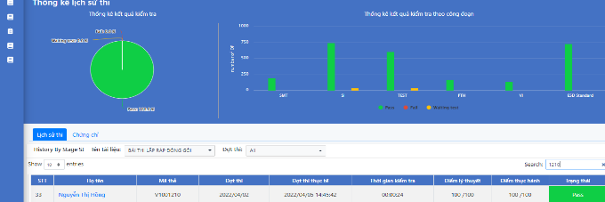
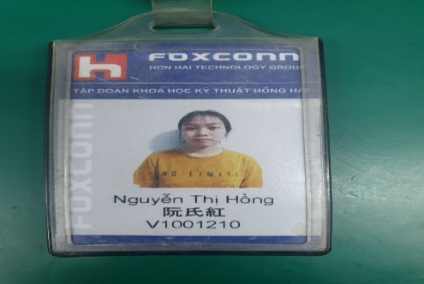
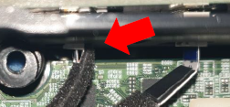
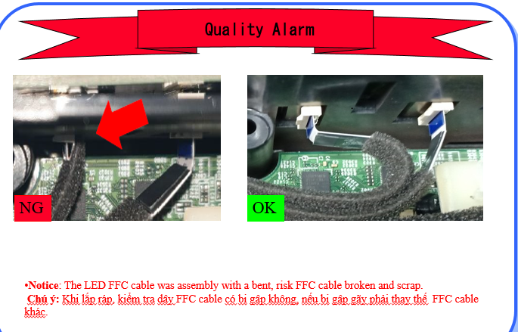
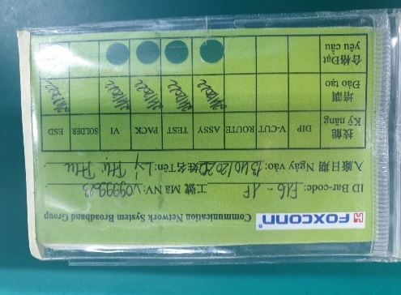
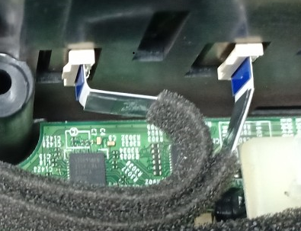
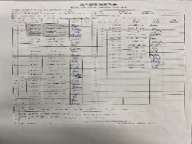
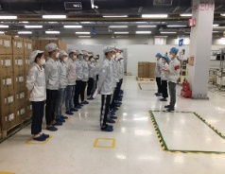
5. LED FFC bad assembly
Issue Description | Root Cause | Actions | Owner | Due Date | Status
Symptom : LED FFC bad assembly Type: Major Defect unit Q’ty : 1/315 pcs Defect rate : 0.31% | OP doing not carefully at Assembly LED FFC cable wrong SOP defined. Cause FFC cable was folded. 2. V1001210 Nguyen Thi Hong -Line 8. | 1. Update training on system for this OP learned and pass exam. Status : Done 2. Hang quality arlam on this station for OP notice it. Status : Done 3. Before run line , line leader training OP, notice quality online issue, IPQC defect issue, OBA issue, read SOP and quality alarm. Status : Done | PQE:Rachel IE: Mei Ling PD:Van Anh ME: Cheng Lun SQE: Mouse | 27-Apr

Slide 9
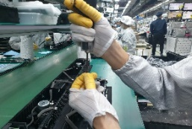
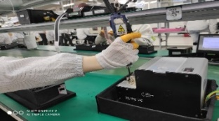
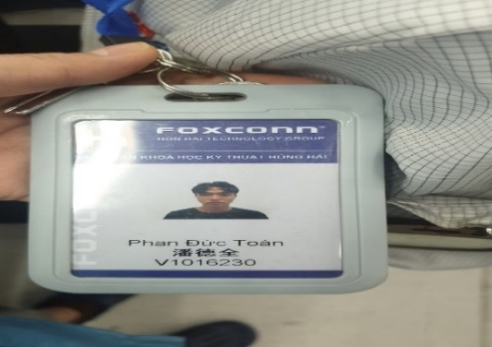
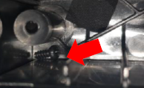
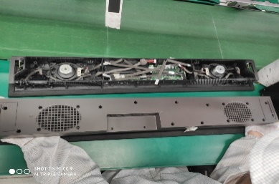
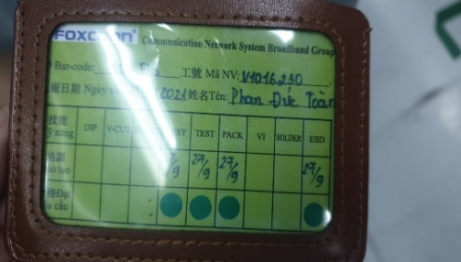
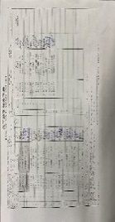
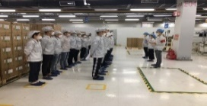
6. Inside the screw
Issue Description | Root Cause | Actions | Owner | Due Date | Status
Symptom : Inside the screw Type: Major Defect unit Q’ty : 1/315 pcs Defect rate : 0.31% | 1. This station maybe OP use hand take screw out machine drop inside product, OP no upside down product before final Top case housing. ( SOP define it ) 2. V1016230 Phan Duc Toan Line 8. | 1. Doing follow SOP ( SOP define take screw by machine, not by hand). Status : Done 2. Request each OP doing must have self check, re-check and final check. Status : Done 3. Before run line , line leader training OP, notice quality online issue, IPQC defect issue, OBA issue, read SOP and quality alarm. Status : Done | PQE:Rachel IE: Mei Ling PD:Van Anh ME: Cheng Lun SQE: Mouse | 27-Apr
OK

Slide 10

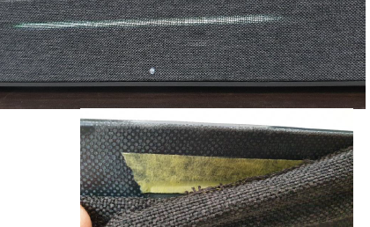
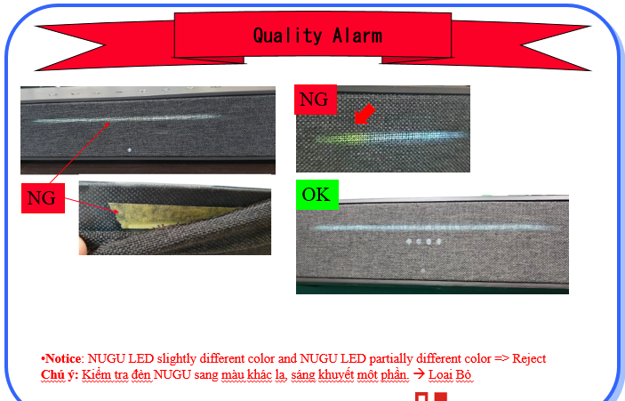
7. NUGU LED slightly different color
Issue Description | Root Cause | Actions | Owner | Due Date | Status
Symptom : NUGU LED slightly different color Type: Major Defect unit Q’ty : 1/315 pcs Defect rate : 0.31% | 1. Online product no rip off check inside GRILL before assembly. 2. SQE checking with Inkel vendor to find out root cause. | Add to SOP OK and NG LED when OP check function LED. Status : Done Hang quality arlam on FT3 station and OBA station check LED. Status : Done | PQE:Rachel IE: Mei Ling PD:Van Anh ME: Cheng Lun SQE: Mouse | 27-Apr

Slide 11

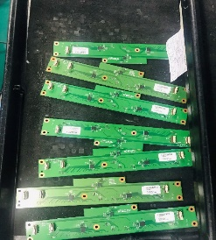
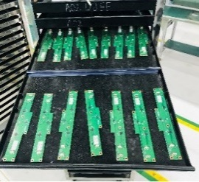
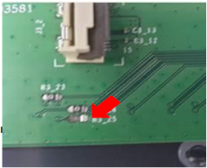
8. NUGU LED partially different color
Issue Description | Root Cause | Actions | Owner | Due Date | Status
Symptom : NUGU LED partially different color Type: Major Defect unit Q’ty : 1/315 pcs Defect rate : 0.31% | Resistor R3_25 broken : Root cause: Because the product after cutting the plate, must wait for the assembly materials, so it is necessary to pack the PCBA. The product is placed on the carrier Tray, in the process of moving the PCBAs close to each other, they collide, leading to broken components. | Corrective Actions: As a partition between products, the purpose is to reduce the possibility of collisions between PCBAs. Status : Done Ask the operator not to place too many PCBA on 1 wall of the transport carrier TRAY. Remind staff to pay attention to the operation steps and update the attention items into the SOP of the operating stations. Status : Done Add to SOP OK and NG LED when OP check function LED. Status : Done Add auto test LED by fixture ( FT1 station ). Status : Done Hang quality arlam on FT3 station and OBA station check LED. Status : Done | PQE:Rachel IE: Mei Ling PD:Van Anh ME: Cheng Lun SQE: Mouse | 27-Apr
Before Improved
After Improved

Slide 12

8. NUGU LED partially different color
Issue Description | Root Cause | Actions | Owner | Due Date | Status
Symptom : NUGU LED partially different color Type: Major Defect unit Q’ty : 1/315 pcs Defect rate : 0.31% | Resistor R3_25 broken : Root cause: Because the product after cutting the plate, must wait for the assembly materials, so it is necessary to pack the PCBA. The product is placed on the carrier Tray, in the process of moving the PCBAs close to each other, they collide, leading to broken components. | Corrective Actions: As a partition between products, the purpose is to reduce the possibility of collisions between PCBAs. Status : Done Ask the operator not to place too many PCBA on 1 wall of the transport carrier TRAY. Remind staff to pay attention to the operation steps and update the attention items into the SOP of the operating stations. Status : Done | PQE:Rachel IE: Mei Ling PD:Van Anh ME:Cheng Lun SQE: Mouse | 27-Apr
Before Improved
After Improved

Slide 13
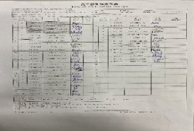

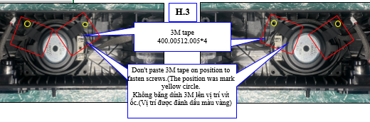
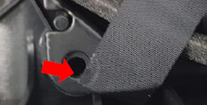
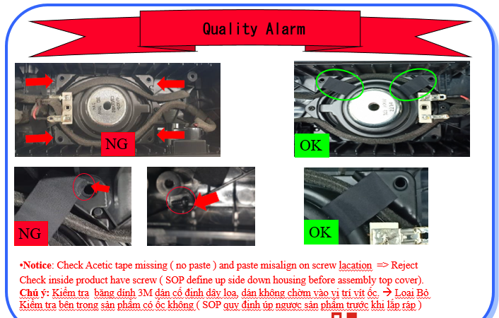
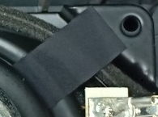
9. Acetic tape miss align
Issue Description | Root Cause | Actions | Owner | Due Date | Status
Acetic tape miss align Type: Minor Defect unit Q’ty : 1pcs / 315 carton •Defect rate : 0.31% | 1. OP doing no follow SOP. | Training OP doing follow SOP. Status : Done Hang quality arlam on this station for OP doing notice it. Status : Done | PQE:Rachel IE: Mei Ling PD:Van Anh ME: Cheng Lun SQE: Mouse | 27-Apr

Slide 14
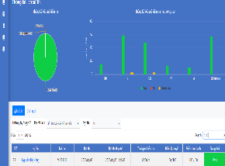
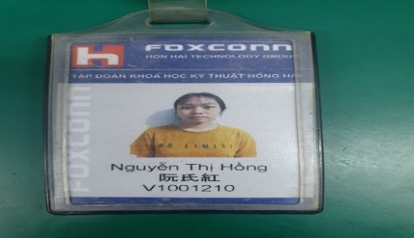
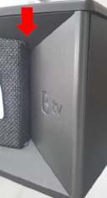
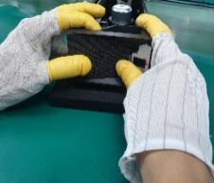




10. Grill assembly NG
Issue Description | Root Cause | Actions | Owner | Due Date | Status
Grill assembly NG Type: Minor Defect unit Q’ty : 1pcs / 315 carton •Defect rate : 0.31% | 1. OP doing not carefully at Assembly Grill wrong SOP defined. Cause Grill assy not fully assembly. 2. V1001210 Nguyen Thi Hong -Line 8. | 1. Update training on system for this OP learned and pass exam. Status : Done 2. Update NG picture to SOP. Status : Done 3. Before run line , line leader training OP, notice quality online issue, IPQC defect issue, OBA issue, read SOP and quality alarm. Status : Done | PQE:Rachel IE: Mei Ling PD:Van Anh ME: Cheng Lun SQE: Mouse | 27-Apr

Slide 15


4. Cosmetic issue
Issue Description | Root Cause | Actions | Owner | Due Date | Status
Cosmetic issue Type: Minor Top scratch and Bottom scratch | 1. TOP & BOT housing scratch ( without feel ) on AA side and A side . Notice OP check when VI product, special AA side , logo and text sletter location. | Hang quality arlam on VI station and OBA station for OP doing notice it. Status : Done | PQE:Rachel IE: Mei Ling PD:Van Anh ME: Cheng Lun SQE: Mouse | 27-Apr

